Slide 1

A Global Perspective on Life Expectancy: Analyzing the Impact of Health, Economic, and Environmental Variables Across Countries and Regions
Ibrahim Kibui Kiria Adm No. 190977

Slide 2

INTRODUCTION
The study of life expectancy across different countries and regions was essential for understanding the various factors that contributed to the health and well-being of populations worldwide.
Life expectancy was influenced by a range of variables, including health-related factors like access to healthcare and the prevalence of diseases, economic conditions such as income levels and unemployment rates, and environmental factors like CO2 emissions and sanitation access (WHO, 2020).
Therefore, this study provides a detailed analysis of global life expectancy from 2001 to 2019, focusing on the complex interplay between these health, economic, and environmental factors.
By examining key variables such as health and education expenditure, CO2 emissions, and rates of undernourishment and unemployment across different countries and regions, the study aims to uncover how these elements collectively influence longevity (Marmot, 2015).
The goal is to provide insights into the dynamics affecting life expectancy, highlighting trends and disparities that could inform global health and policy strategies.

Slide 3

Objectives
General Objective: The general objective of this project is to analyze the factors influencing life expectancy across different countries and regions, focusing on health, economic, and environmental variables to identify key determinants and disparities that could guide effective policy interventions.
Specific Objectives:
To examine the relationship between life expectancy and various health, economic, and environmental variables across countries and regions.
To identify the key determinants of life expectancy and assess their relative impact.
To explore regional disparities in life expectancy and the contributing factors.
To provide policy recommendations for improving life expectancy based on the findings.
Study Questions:
What are the primary health, economic, and environmental factors that influence life expectancy across different countries and regions?
How do these factors vary between high-income and low-income regions?
What are the most significant challenges facing regions with lower life expectancy?
How can policy interventions be tailored to address the specific needs of regions with low life expectancy?

Slide 4

Literature Review
The literature on life expectancy has consistently shown that it is a multifaceted issue influenced by a variety of factors.
Previous studies have highlighted the role of healthcare access, economic stability, and environmental conditions in determining life expectancy.
Health expenditure, for instance, has been shown to be a crucial determinant, with countries investing more in healthcare generally achieving higher life expectancy (Cutler, Deaton, & Lleras-Muney, 2006).
Economic factors like income levels and unemployment rates also play a significant role, as they directly affect the quality of life and access to necessary services (Bloom & Canning, 2000).
Environmental factors, including CO2 emissions and sanitation access, further complicate the picture, as they are indicative of broader socio-economic conditions that impact public health (WHO, 2020).
Despite the extensive research on these factors, gaps remain in understanding the complex interplay between them across different regions and income groups, necessitating further study to develop targeted interventions.

Slide 5
METHODOLOGY
This study utilized a quantitative approach, analyzing data on life expectancy and associated variables from a global dataset (Deaton, 2013).
The data included variables such as life expectancy, health expenditure as a percentage of GDP, CO2 emissions, education expenditure, unemployment rates, corruption scores, and sanitation access across various countries and regions (Marmot, 2015).
Statistical techniques, including correlation analysis and regression modeling, were employed to identify the relationships between these variables and life expectancy.
The analysis was conducted across different regions and income groups to identify patterns and disparities, and to draw conclusions about the key determinants of life expectancy on a global scale (Cutler, Deaton, & Lleras-Muney, 2006).

Slide 6

DATA ANALYSIS AND RESULTS

Slide 7
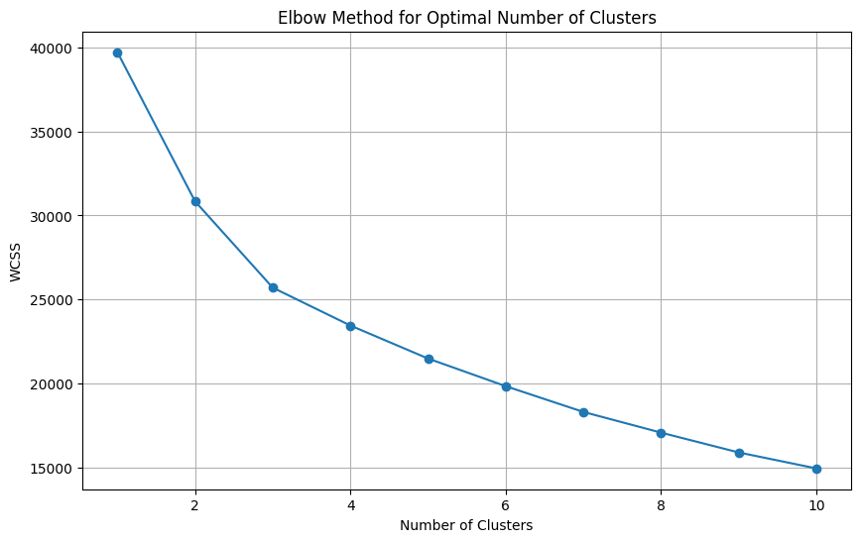
Identification of Optimal Clusters Using the Elbow Method
The Elbow Method plot was utilized to determine the optimal number of clusters for the dataset by analyzing the within-cluster sum of squares (WCSS) as the number of clusters (k) increased.
WCSS - measures the compactness of the clusters by summing the squared distances between each data point and the centroid of its respective cluster.
The plot initially showed a steep decline in WCSS, indicating that adding clusters significantly improved compactness.
However, as more clusters were added, the reduction in WCSS began to level off, forming an "elbow" in the curve.
The elbow point in the curve typically indicates the optimal number of clusters, as it represents the point beyond which additional clusters provide diminishing returns in reducing WCSS.
In this case, although the elbow was not sharply defined, it appeared around 3 clusters, which was selected as the optimal number for this dataset.
This choice implies that the data could be meaningfully divided into three distinct groups, likely representing different patterns or characteristics within the dataset related to life expectancy and associated variables.

Slide 8
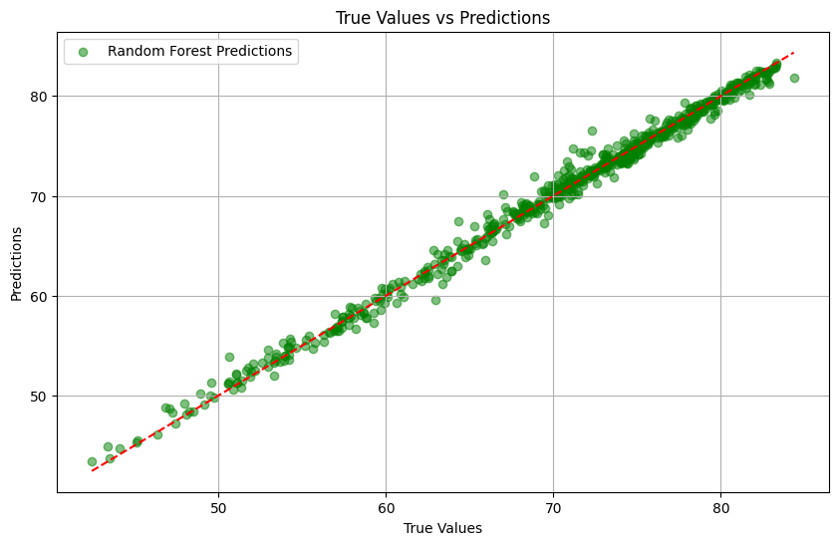
Random Forest Model Performance: True Values vs Predictions
The graph illustrated the performance of the Random Forest regression model in predicting life expectancy values.
In the plot, each green dot represented a pair of actual life expectancy values (from the test dataset) and the corresponding predictions made by the model.
The proximity of these dots to the red dashed line indicated how well the model's predictions aligned with the true values.
The red dashed line symbolized the ideal scenario where predicted values would perfectly match the true values, meaning that a perfect model would have all data points lying exactly on this line.
Regarding the model performance, the green dots were closely clustered around the red dashed line, suggesting that the model's predictions were quite accurate.
Although there were minor deviations, indicating some small prediction errors, the overall performance of the model appeared to be strong.
In conclusion, the Random Forest model demonstrated a good fit, with most predictions closely matching the actual values, suggesting that it effectively captured the underlying patterns in the life expectancy data.

Slide 9
Descriptive Statistics of Global Disparities in Life Expectancy
The descriptive statistics revealed significant global disparities in key indicators affecting life expectancy.
The average life expectancy across the dataset was approximately 70 years, with notable variability ranging from 40 to 84 years.
The prevalence of undernourishment showed wide variation, with some countries experiencing minimal rates (2.5%) while others faced severe challenges (up to 70.9%).
CO2 emissions and health expenditure percentages exhibited substantial differences, with CO2 emissions ranging from as low as 10 metric tons to over 10 million metric tons, and health expenditures varying from 1.26% to 24.23% of GDP.
Education expenditure demonstrated a similar pattern of disparity, ranging from 0.85% to 23.27%.
Unemployment rates reflected economic diversity, varying from 0.1% to 37.25%.
Access to sanitation was another area of concern, with the percentage of populations with access ranging from as low as 2.38% to full access (100%).
The data on injuries, communicable, and non-communicable diseases indicated significant differences in health burdens, further illustrating the complex factors influencing global life expectancy.

Slide 10
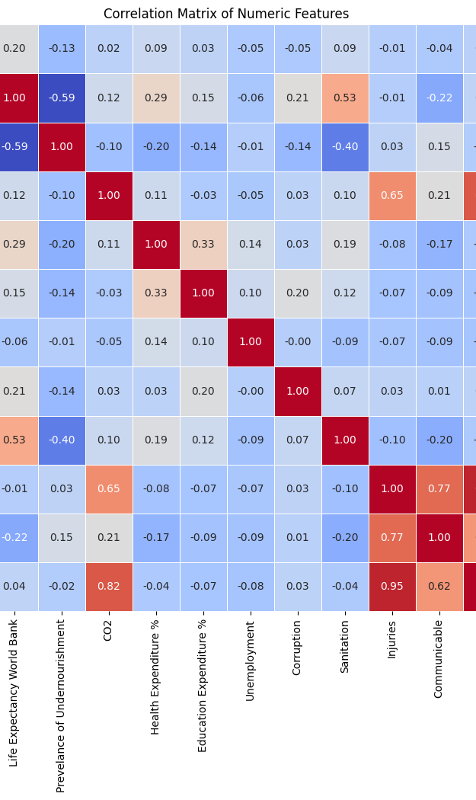
Calculation of the Correlation Matrix
Life expectancy was negatively correlated with the prevalence of undernourishment (-0.59), indicating that higher undernourishment led to lower life expectancy.
CO2 emissions were positively correlated with life expectancy (0.12) but showed a stronger correlation with non-communicable diseases (0.82), linking industrial activity to chronic health issues.
Health expenditure was positively correlated with both life expectancy (0.15) and education expenditure (0.33), suggesting that higher investments in health and education contributed to longer life spans.
Unemployment had a weak negative correlation with life expectancy (-0.06), while sanitation was positively correlated (0.53), highlighting the significance of sanitation in public health.
Corruption showed a weak positive correlation with life expectancy (0.21), possibly indicating offsetting factors in some regions.
Injuries, communicable diseases, and non-communicable diseases were negatively correlated with life expectancy, with non-communicable diseases having the strongest negative correlation (-0.22).
The matrix underscored the intricate connections between health, environmental, and socio-economic factors, pointing to key areas for policy interventions to enhance life expectancy.

Slide 11
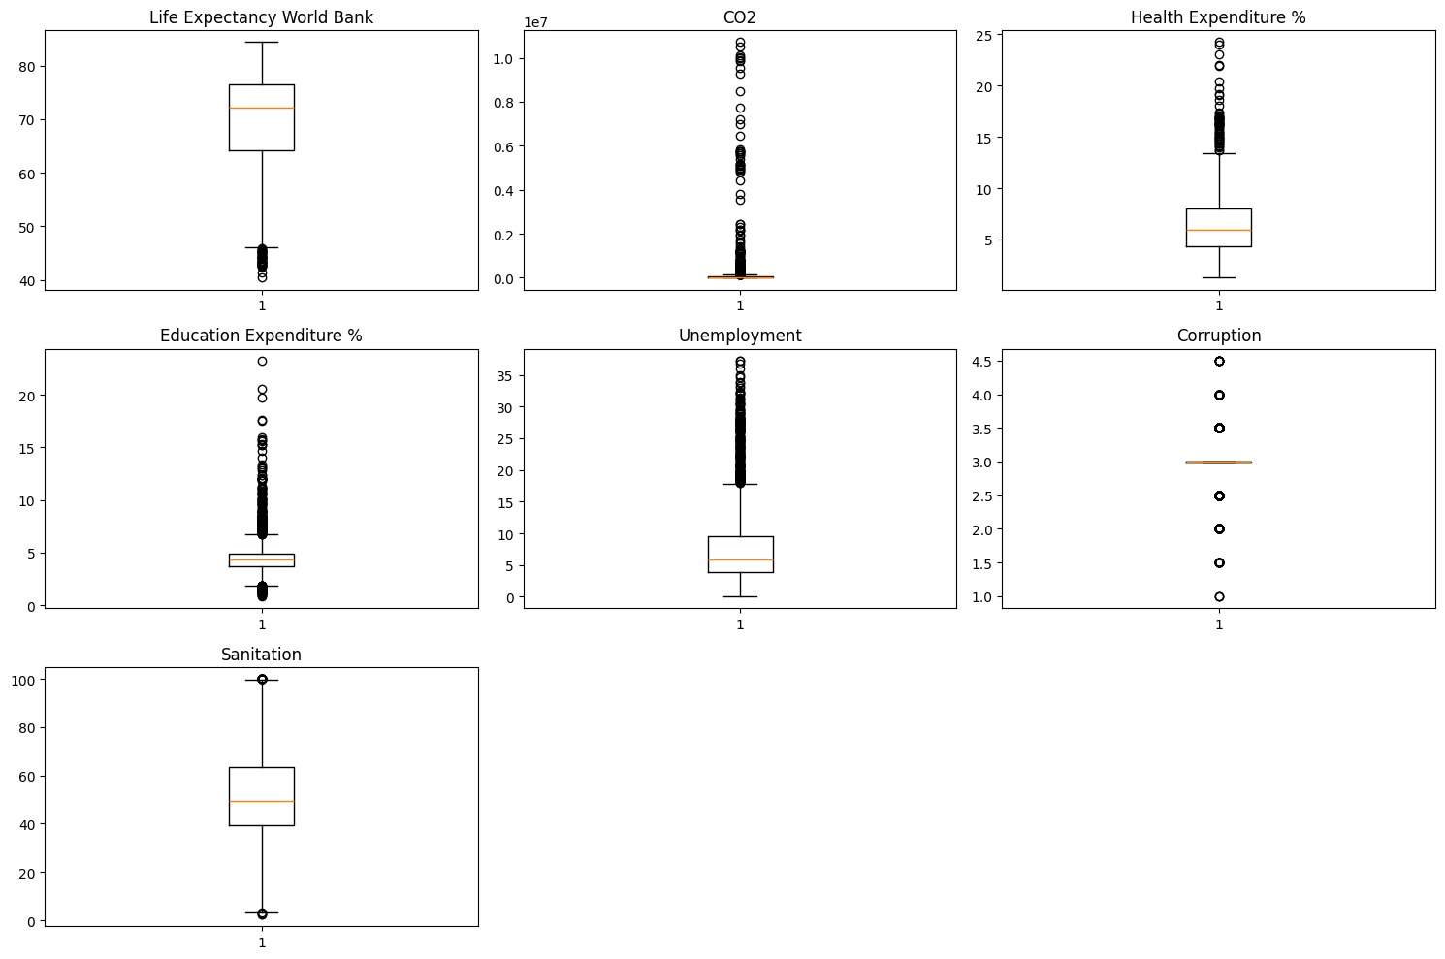
Distribution of Key Variables
The boxplots provided a visual summary of the distribution of key variables related to life expectancy and other significant factors across various countries.
The median life expectancy was around 70 years, with notable outliers on the lower end, highlighting countries with life expectancies as low as 40 years, indicative of severe health or socio-economic challenges.
CO2 emissions displayed a heavily skewed distribution, where most countries had relatively low emissions, but a few contributed disproportionately, likely due to industrial activities or high energy consumption.
Health expenditure as a percentage of GDP varied, with most countries spending between 4% and 10%, though outliers spent up to 24%, reflecting significant healthcare investment relative to economic output.
Education expenditure also varied, with a median around 5% of GDP, and some countries investing over 15%, indicating a strong emphasis on education.
Unemployment rates ranged widely, with most countries between 4% and 10%, but some experienced extreme rates up to 37%, suggesting economic distress.
Corruption scores generally clustered between 1 and 3, indicating low to moderate levels of perceived corruption, with some outliers scoring higher, pointing to higher corruption levels in certain regions.
Sanitation access was spread out, with a median of 50-60%, and outliers showing significant disparities in infrastructure, from nearly full access to very limited access in some countries.
These findings underscored the significant global disparities in life expectancy, environmental impact, and socio-economic conditions, emphasizing the need for targeted policy interventions.

Slide 12
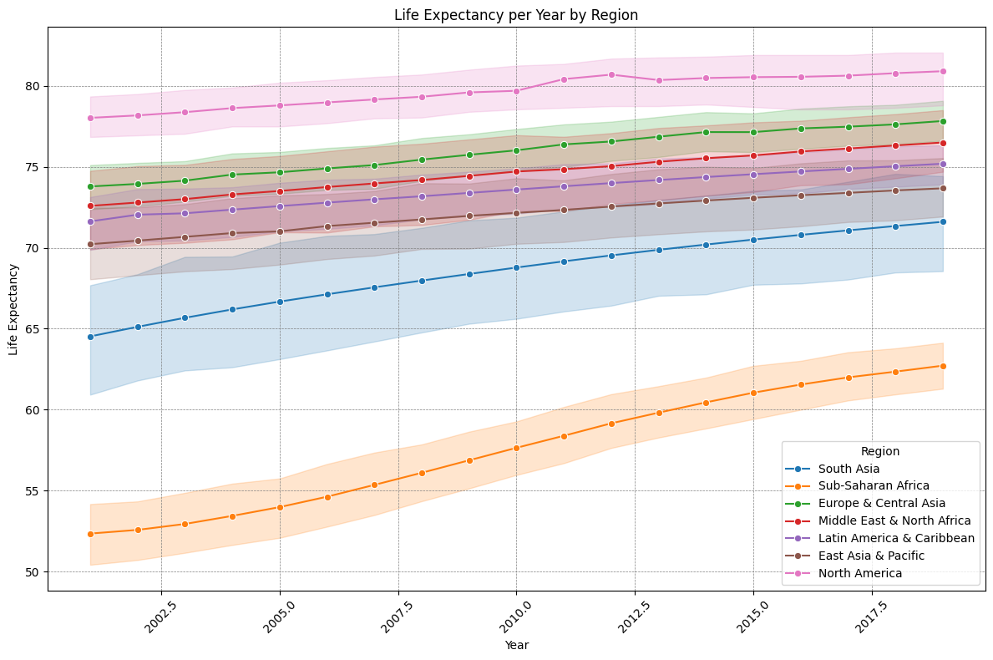
Life Expectancy per year by Region
The graph displayed the following observations:
North America consistently had the highest life expectancy, with values consistently above 78 years, showing a stable trend.
East Asia & Pacific also showed high life expectancy, maintaining levels around 75-77 years, with a steady increase over time.
Europe & Central Asia, Latin America & Caribbean, and the Middle East & North Africa regions followed closely, with life expectancy ranging between 70-75 years.
South Asia had a lower life expectancy, starting at around 64 years but showed a notable upward trend, reaching approximately 67 years by the end of the period.
Sub-Saharan Africa had the lowest life expectancy, starting below 55 years, but also showed an upward trend, reaching close to 60 years by the end of the period.
The data indicated a global improvement in life expectancy across all regions, with varying degrees of progress, highlighting significant regional disparities.

Slide 13
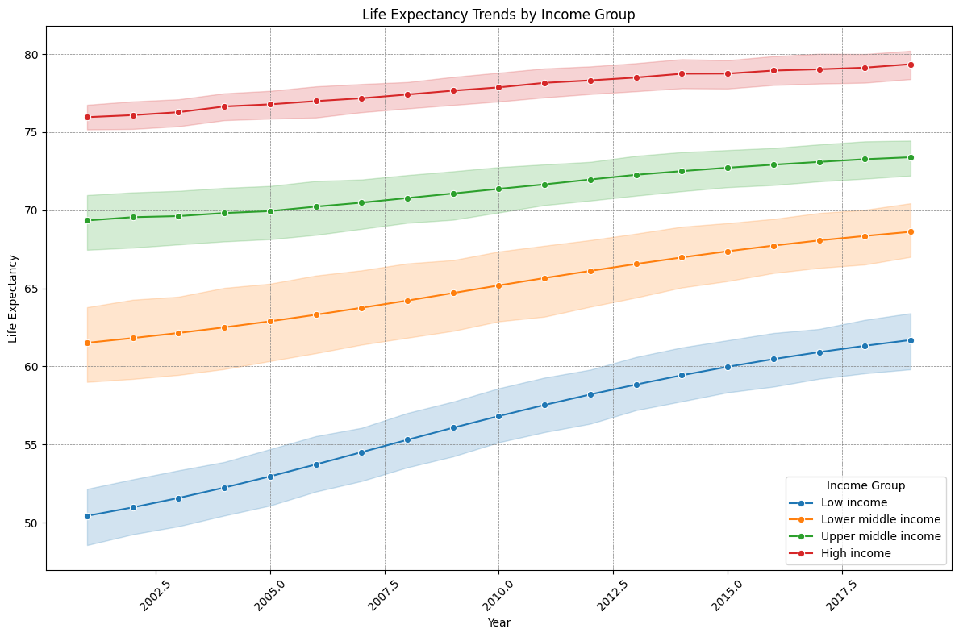
Life Expectancy Trends by Income Group
The graph illustrates life expectancy trends from 2000 to 2018 across Low, Lower middle, Upper middle, and High-income groups.
High-income countries consistently had the highest life expectancy, rising from around 77 years in 2000 to about 80 years by 2018, with minimal variability.
Upper middle-income countries followed, with life expectancy increasing from around 69 to 75 years during the same period, showing moderate variability.
Lower middle-income countries saw an increase from about 60 to 67 years, with greater variability.
Low-income countries had the lowest life expectancy, starting around 50 years and rising to about 59 years by 2018, with significant variability.
The overall upward trend across all groups reflects improvements in healthcare and living conditions. However, the evident gap between income groups highlights disparities in life expectancy based on economic status, with wealthier countries enjoying better health outcomes. This underscores the importance of economic factors in determining life expectancy and the need for policies to reduce health disparities across income levels.

Slide 14

DISCUSSION & CONCLUSIONS
Discussion:
The Random Forest regression model performed well in predicting life expectancy, with most predictions closely matching the actual values. The analysis of life expectancy trends across income groups revealed significant disparities, with high-income countries showing consistently higher life expectancy compared to low-income countries. The clustering analysis suggested that the data could be meaningfully divided into three groups, likely reflecting different socio-economic and environmental conditions.
Conclusion:
The findings confirm that life expectancy is strongly influenced by economic status, healthcare access, and socio-economic factors. While there has been a global increase in life expectancy, the persistent gap between high and low-income groups underscores the need for targeted interventions to address these inequalities.

Slide 15

RECOMMENDATIONS
Recommendations:
To reduce the life expectancy gap, low and lower-middle-income countries should focus on improving healthcare access, particularly primary care and preventive measures. Economic policies aimed at poverty reduction and job creation are also crucial. Additionally, investing in environmental health programs can address key issues like undernourishment and poor sanitation in low-income regions.
Model Improvement Recommendations:
To further enhance predictive accuracy, consider refining the model by incorporating additional variables or exploring other machine learning techniques. Regularly updating the model with new data will also help maintain its relevance and accuracy in predicting life expectancy trends.

Slide 16

REFERENCES
Bloom, D. E., & Canning, D. (2000). The health and wealth of nations. Science, 287(5456), 1207-1209. https://doi.org/10.1126/science.287.5456.1207
Cutler, D. M., Deaton, A. S., & Lleras-Muney, A. (2006). The determinants of mortality. Journal of Economic Perspectives, 20(3), 97-120. https://doi.org/10.1257/jep.20.3.97
Deaton, A. (2013). The great escape: Health, wealth, and the origins of inequality. Princeton University Press.
Marmot, M. (2015). The health gap: The challenge of an unequal world. Bloomsbury Publishing.
World Health Organization (WHO). (2020). World health statistics 2020: Monitoring health for the SDGs, sustainable development goals. World Health Organization.

Slide 17

THANK YOU

